Slide 1
Hardware based Intrusion Detection System
2ND Progress Report

Slide 2
Steps Completed
Installing Minibian OS
Setting up Pi
Adding User
Installing WiFi and Bluetooth Drivers
Installing the DHCP server

Slide 3
Steps Completed (cont..)
Installing HostAPD
Configure the ISC-DHCP-Server
Configuring HostAPD
instantiating Router
NAT Configuration

Slide 4
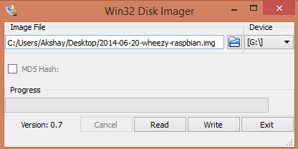
Installing OS

Slide 5
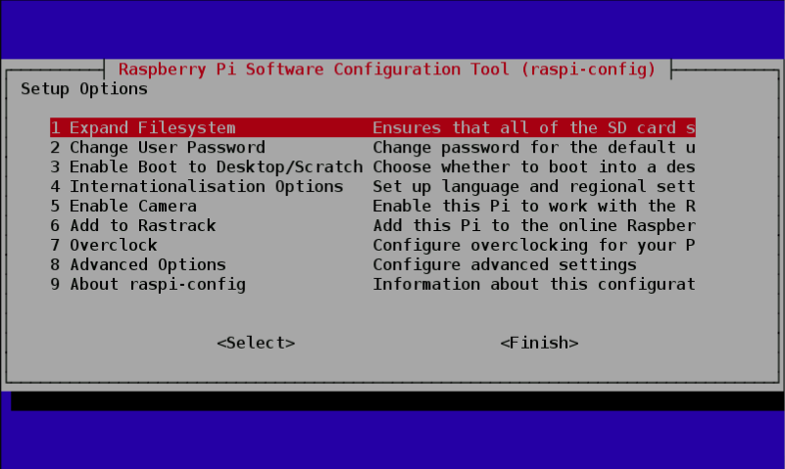
Setting Up Pi
Updating Debian Packages :
Sudo apt-get update
Sudo apt-get upgrade
Upgrading Firmware :
Sudo apt-get rpi-config
Sudo rpi-update

Slide 6
Adding User and installing drivers
Add user commands:
Useradd username(pi)
Password(pids)
sudo apt-get install firmware-brcm80211 pi-bluetooth wpasupplicant
Sudo apt-get install hostapd

Slide 7
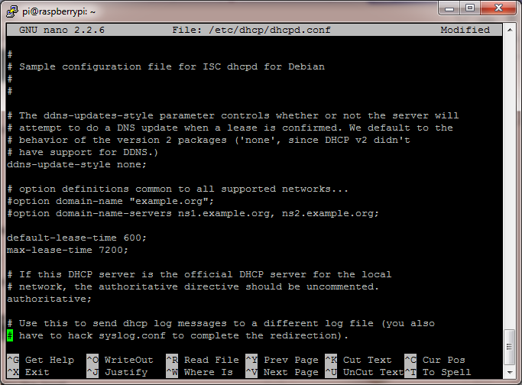
Installing and configuring DHCP server
sudo apt-get install isc-dhcp-server
Configuring:
sudo nano /etc/dhcp/dhcpd.conf
commenting:
option domain-name "example.org";
option domain-name-servers ns1.example.org, ns2.example.org;
un-commenting:
#authoritative;

Slide 8
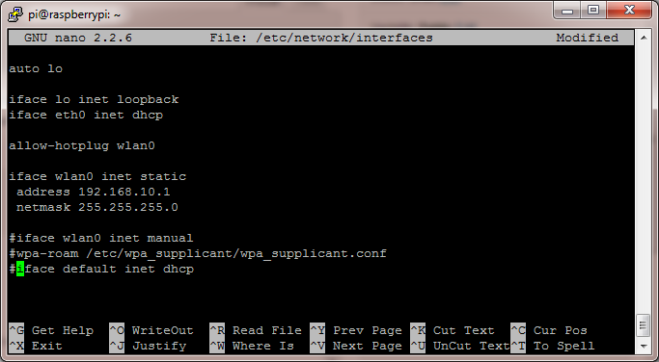
Cont..
adding:
subnet 192.168.10.0 netmask 255.255.255.0 {
range 192.168.10.10 192.168.10.20;
option broadcast-address 192.168.10.255;
option routers 192.168.10.1;
default-lease-time 600;
max-lease-time 7200;
option domain-name "local-network";
option domain-name-servers 8.8.8.8, 8.8.4.4;
}
sudo nano /etc/default/isc-dhcp-server
specifying wireless interface
INTERFACES="wlan0"
Giving Static IP Address to Pi:
sudo ifdown wlan0
sudo nano /etc/network/interfaces

Slide 9
Configuring HostAPD
AP name and Pass:
sudo nano /etc/hostapd/hostapd.conf
adding:
“ssid=wifi”
“wpa_passphrase=YourPassPhrase”
Enabling NAT:
sudo nano /etc/sysctl.conf
adding:
net.ipv4.ip_forward=1
sudo sh -c "echo 1 > /proc/sys/net/ipv4/ip_forward"

Slide 10
NAT configuration
translation between the ethernet and wireless card
sudo iptables -t nat -A POSTROUTING -o eth0 -j MASQUERADE
sudo iptables -A FORWARD -i eth0 -o wlan0 -m state --state RELATED,ESTABLISHED -j ACCEPT
sudo iptables -A FORWARD -i wlan0 -o eth0 -j ACCEPT

Slide 11
NAT Configuration (cont..)
backing up NAT Config
sudo sh -c "iptables-save > /etc/iptables.ipv4.nat"
adding NAT Config to interface file
sudo nano /etc/network/interfaces
adding:
up iptables-restore < /etc/iptables.ipv4.nat

Slide 12
Instantiating router
Starting router
sudo service isc-dhcp-server start
sudo service hostapd start
Run At Startup
sudo update-rc.d hostapd enable
sudo update-rc.d isc-dhcp-server enable

